Slide 1
PDS
SDN
NFV
Computer Vision
11_6. Op Amp_Topologi FeedBack Negatif (FBN)
Umpan Balik Negatif
https://github.com/siagianp
https://www.youtube.com/@AmelOline/videos
https://github.com/amelcharolinesgn2/IoT_simulator-mqtt-NodeRed
https://github.com/amelcharolinesgn2/Cloud-Infrastructures
https://github.com/amelcharolinesgn2/ClouD-Infrastructure-SISKA-2025
Notes:
http://www.sophphx.caltech.edu/Physics_5/Experiment_6.pdf
https://ocw.mit.edu/ans7870/RES/RES.6-010/MITRES_6-010S13_comchaptrs.pdf

Slide 2
Op Amp_FeedBack negatif( FBN)
Umpan Balik Negatif
Capaian :
Mengerti op amp feedback negative
Mampu membedakan setiap jenis topologi umpan balik negatif
https://ocw.mit.edu/courses/6-01sc-introduction-to-electrical-engineering-and-computer-science-i-spring-2011/resources/op-amps/
Notes:
https://unacademy.com/lesson/low-frequency-analysis-of-bjt-amplifier/5TUKWO6Z
https://ocw.mit.edu/courses/6-01sc-introduction-to-electrical-engineering-and-computer-science-i-spring-2011/resources/op-amps/

Slide 3
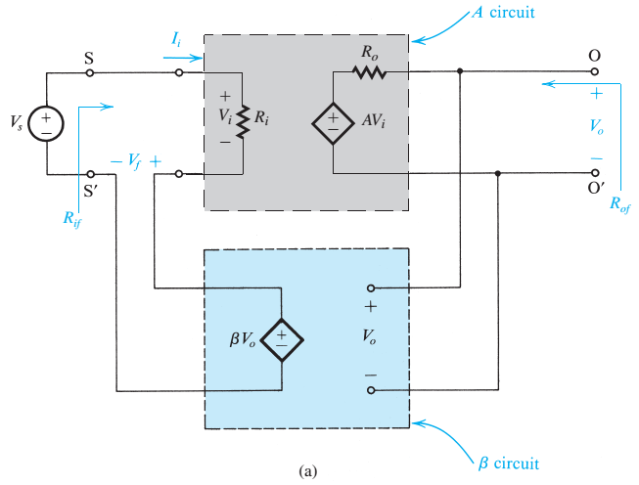



1) Topologi FBN: Penguat Tegangan
Sinyal input: Tegangan,
Sinyal output: Tegangan
Topologi UBN: SERIES - SHUNT
Input: Series (voltage) mixing
Output: Shunt (voltage) sampling (ingat volt-meter)
Notes:
Seri – Tegangan
> Zi - < Zo
no branch – yes branch
Rof saat Vs=0

Slide 4
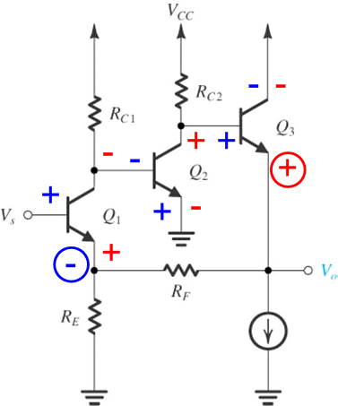
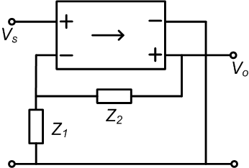
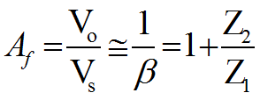
1) FeedBack Negatif Penguat Tegangan
R_{E} ≡ Z₁, R_{F} ≡ Z₂

Slide 5
Contoh

Slide 6
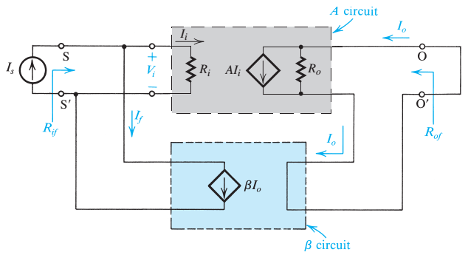



2) Topologi FBN: Penguat Arus
Sinyal input: arus,
Sinyal output: arus
Topologi UBN: SHUNT - SERIES
Input: Shunt (current) mixing
Output: Series (current) sampling (ingat amp-meter)
Notes:
Paralel – Arus
< Zi - > Zo
yes branch – no branch
Rof saat Is=0

Slide 7
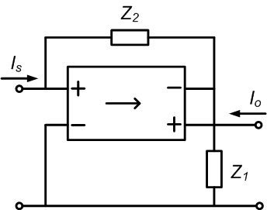
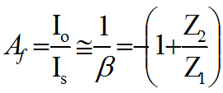
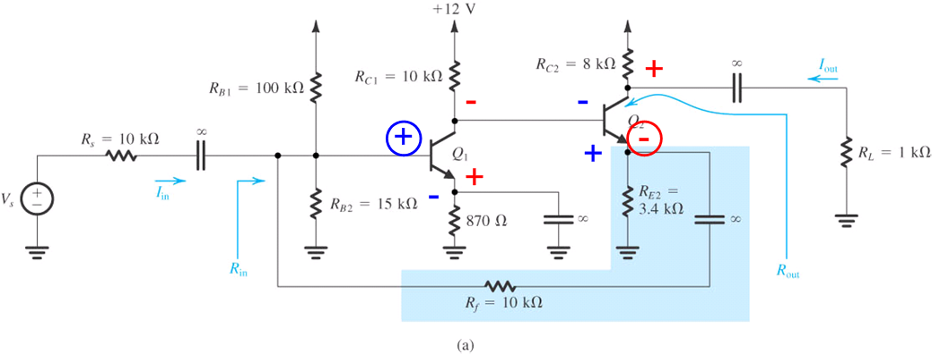
2) FBN Penguat Arus
R_{E2} ≡ Z₁, R_{f} ≡ Z₂

Slide 8
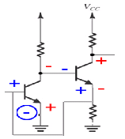















$$i_{0}$$
3 k ohm
500 ohm
$$R_{C2}$$
$$R_{C1}$$
$$Vout$$
$$Q_{2}$$
1,2 k ohm
$$R_{s}$$
$$Q_{1}$$
1,2 k ohm
$$R_{F}$$
$$R_{E}$$
50 ohm
$$h_{ir}$$
= 1,2 k
$$h_{fe}$$
= 50
$$h_{re}$$
=
$$h_{oe}$$
= 0

Slide 9
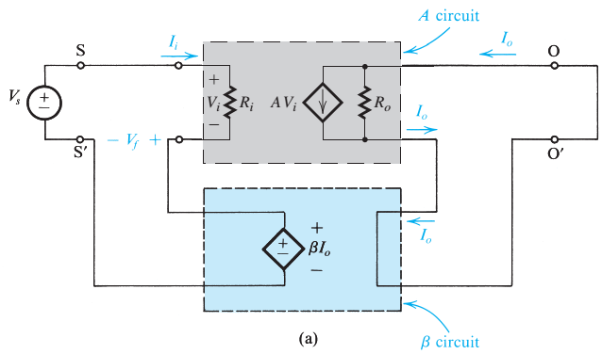


3) Topologi FBN: Penguat Trans-Konduktansi
Sinyal input: tegangan,
Sinyal output: arus
Topologi FBN: SERIES - SERIES
Input: Series (voltage) mixing
Output: Series (current) sampling (ingat amp-meter)
Notes:
Seri – Arus
> Zi - > Zo
no branch – no branch

Slide 10
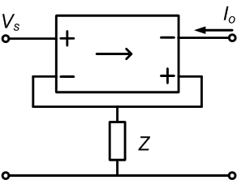
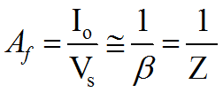
3) FBN Penguat Trans-Konduktansi
R_{F} ≡ Z

Slide 11
Contoh :

Slide 12
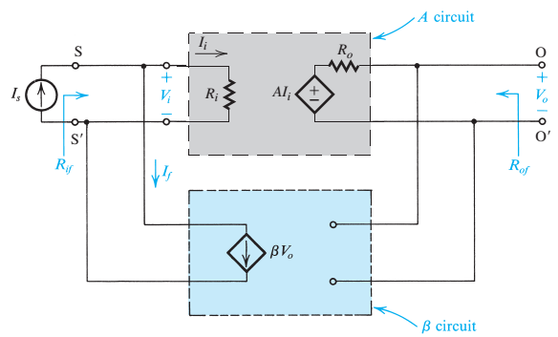

4) Topologi FBN: Penguat Trans-Impedansi/ Trans-Resistansi
Sinyal input: arus,
Sinyal output: tegangan
Topologi FBN: SHUNT- SHUNT
Input: Shunt (arus) mixing
Output: Shunt (tegangan) sampling (ingat volt-meter)
Notes:
Paralel – Tegangan
< Zi - < Zo
yes branch – yes branch

Slide 13
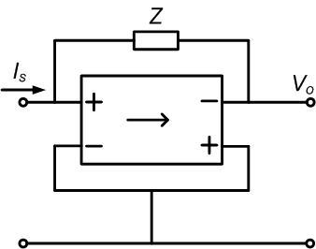
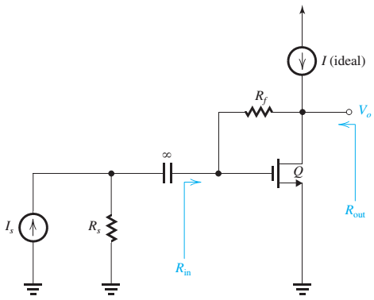
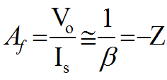
4) FBN Penguat Trans-Impedansi
-
+
-
+

Slide 14
Contoh

Slide 15
Kesimpulan
Topologi FBN (penguat arus, tegangan, transkonduktansi, atau transimpedansi): disesuaikan dengan sinyal input (sumber) /output (terkendali)
Input:
Tegangan; butuh R_{in} sebesar mungkin sehingga dipilih Series-Mixing.
Arus; butuh R_{in} sekecil mungkin sehingga dipilih Shunt-Mixing
Output:
Tegangan; butuh R_{out} sekecil mungkin sehingga dipilih Shunt (voltage – Sampling).
Arus; butuh R_{out} sebesar mungkin sehingga dipilih Series (current – Sampling).

Slide 16
PDS
SDN
NFV
Computer Vision
Thank You !!
See the next
https://github.com/siagianp
https://www.youtube.com/@AmelOline/videos
https://github.com/amelcharolinesgn2/IoT_simulator-mqtt-NodeRed
https://github.com/amelcharolinesgn2/Cloud-Infrastructures
https://github.com/amelcharolinesgn2/ClouD-Infrastructure-SISKA-2025

Slide 17
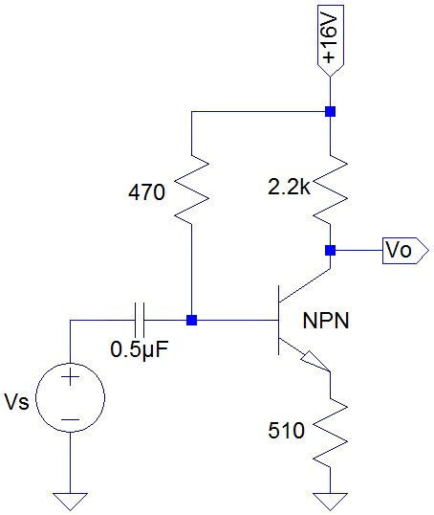
HW
Lakukan analisis untuk umpan balik negatif bertikut:
Notes:
https://ocw.mit.edu/courses/6-720j-integrated-microelectronic-devices-spring-2007/pages/lecture-notes/
https://ocw.mit.edu/courses/6-01sc-introduction-to-electrical-engineering-and-computer-science-i-spring-2011/resources/op-amps/

